Slide 1
Processing High-Scale Messaging using Service Bus, Event Hub & IoT Hub

Slide 2
Agenda
Azure IoT reference architecture
Pushing and reading messages
Event Hub
IoT Hub
Scaling patterns
Command Control Introduction
Notes:
This session with introduce the IoT architecture, show samples on how to push messages to an event hub, an Iot hub. Show examples on how to read messages and introduce the concept of command and control.
We will also discuss scaling options and patterns for understanding how to architect an IoT solution.

Slide 3










Azure IoT Reference Architecture
Devices and Data Sources
Data Transport
Device and Event Processing
Presentation and Business Process Integration
IP capable devices
Cloud Gateway
Provisioning API
Solution Logic & UI
Agent
Device State Store
Device Registry Store
Existing IoT devices
Agent
Gateway
Stream Event Processing
Agent
Storage
Analytics & Machine Learning
Low power devices
Notes:
Displayed is the IoT reference architecture. It depicts the typical architectural components of most IoT solutions.
Highlight:
Some devices are native “internet talking devices”
Other devices may use different protocols
Some devices may require a protocol translation or may not be internet enabled
Major components of an IoT solution are the provisioning and management of the devices, storage of telemetry data and analytics

Slide 4


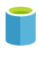
Azure IoT Suite Implementation
Devices and Data Sources
Data Transport
Device and Event Processing
Presentation and Business Process Integration
IP capable devices
Cloud Gateway
Provisioning API
Solution Logic & UI
Agent
Device State Store
Device Registry Store
Existing IoT devices
Agent
Gateway
Stream Event Processor
Agent
Storage
Analytics & Machine Learning
Low power devices
Notes:
With the Azure IoT suite, Azure provides some of the major infrastructure required to quickly get running with IoT solutions.
With every architecture however, there different points of elasticity that are required to build a scalable, available system.
These points are highlighted
<<click>>
How we injest data at scale
How we process the data at scale
How we manage remote monitoring and updates of the devices
These are all scale points we need to consider for an IoT solution. We will dive into these areas during this talk.

Slide 5














Microsoft Azure IoT services portfolio
Devices | Device Connectivity | Storage | Analytics | Presentation & Action
` | Event Hub | SQL Database | Machine Learning | App Service
 | IoT Hub | Table/Blob Storage | Stream Analytics | Power BI
 | Service Bus | DocumentDB | HDInsight | Notification Hubs
 | External Data Sources | 3rd party Databases | Data Factory | Mobile Services
 |  |  | Data Lake | BizTalk Services
{ }

Slide 6
Pushing and reading messages

Slide 7
Azure Service Bus
Azure Service Bus
Relay
NAT and Firewall Traversal Service Request/Response Services Unbuffered with TCP Throttling
Queue
Transactional Cloud AMQP/HTTP Broker High-Scale, High-Reliability Messaging Sessions, Scheduled Delivery, etc.
Topic
Transactional Message Distribution
Up to 2000 subscriptions per Topic
Up to 2K/100K filter rules per subscription
Notification Hub
High-scale notification distribution
Most mobile push notification services
Millions of notification targets
Event Hub
… this session …
IoT Hub

Slide 8
Azure Service Bus
Architecture pattern and middleware designed to make business processes more loosely-coupled and have better interconnectivity between other business processes
Abstracting direct connections to other processes
Messaging
Contains
Queues / Topics
Relay
Notification Hub
Event Hub

Slide 9
Azure Event Hubs
IEventProcessor
Event Processor Host
Azure Event Hub
Direct
Receivers
> 1M Producers > 1GB/sec Aggregate Throughput
Consumer Group(s)
Partitions
Event Producers
PartitionKey
Hash
AMQP 1.0
Credit-based flow control
Client-side cursors
Offset by Id or Timestamp
Throughput Units:
1 ≤ TUs ≤ Partition Count
TU: 1 MB/s writes, 2 MB/s reads
Up to 32 partitions via portal, more on request

Slide 10
Partitions
Segmentation of the event stream for scale-out
Parallelism for consumers pulling events for processing
Parallelism for producers submitting events
Default 16, minimum 8, self-service maximum 32
Azure Support can enable up to 1024 (or more under special conditions)
Maximum 10 Event Hubs per namespace
Sender usage of partitions
Direct targeting with partition-id allowing for sender controlled segmentation
Automatic hash-based distribution by PartitionKey or Publisher Identity
Automatic random distribution

Slide 11
Throughput Units
Throughput Unit (TU): Quota and Billing Concept
Write: Lesser of 1MByte/sec or 1000 message operations/sec (incl. management)
Read: 2MByte/sec
Included retention: 84GByte/day (24h at full ingress rate)
Retention can be expanded w/ self-service up to 7 days, via Azure support up to 30 days
Local-redundant Azure storage pricing for overages applies
Number of Partitions ≥ Throughput Units
At most one throughput unit per partition, minimum is one
10 partitions have 10 TU = 10 MByte/sec throughput ceiling
TUs are applied and enforced at the namespace level, i.e. across Event Hubs
Maximum of 20 TUs per account in self-service.
Further w/ commitments through Azure support (blocks of 20 up to 100, blocks of 100)
Billing
TUs are billed by the hour (!) they are applied to a namespace

Slide 12
Publishers
Very many publishers
Short-lived, low throughput: HTTPS
Long-lived, high throughput: AMQP
Long lived AMQP connections are billable, HTTPS requests are not; AMQP connection allowance included in tier
Publish to …
PartitionId
Direct
PartitionKey
PartitionKey selecting PartitionId
Publisher Policy (<eh>/publishers/<name>)
<name> overriding PartitionKey
Direct
Partitions
Event Producers
PartitionKey
Hash

Slide 13
Consumer Groups
Views on the Event Stream
Conceptually similar to Topic subscriptions in that they are a ‘view’ on the event stream
Organizational anchor for checkpointing (you)
Anchor for creating per-partition receivers
Default consumer group always present
Can create up to 20 named consumer groups
“Receivers read through a consumer group”
Consumer Group(s)

Slide 14
Consumers
Receive from partitions via consumer groups
Using .NET API or using generic AMQP 1.0 client (e.g. Apache Proton-C/J)
Cursors (offsets) solely maintained by clients; not like Queue/Topic
Maximum flexibility for consumption
Can act as raw event history store for retention duration
Not an archive, but raw data value often deteriorates quickly
Can synchronize across streams by timestamp
Checkpoints must be maintained by clients
Direct support for external leader election models with epochs
Partition
Event Log
ID, Time, [Data]
ID, Time, [Data]
Time
ID, Time, [Data]
ID, Time, [Data]
ID, Time, [Data]
ID

Slide 15
Sending events to event hub

Slide 16
Scaling patterns

Slide 17
Intermediaries and Brokers
AuthN/Z
Backpressure Feedback
S
Intermediary
R
Route
Intermediaries route messages ‘straight through’ with feedback path and network backpressure into sender
S
AuthN/Z
Broker
R
Query
Filter
Pull
Brokers hold messages for retrieval and querying

Slide 18
Push vs. Pull
S
Intermediary
R
‘Push’ is a sender initiated activity that results in delivery of a message to a receiver without the receiver explicitly asking for one or a particular message.
S
Broker
R
‘Pull’ is a receiver initiated activity that delivers stored messages to the receiver in a context that the receiver controls. The context is decoupled from the ‘Push’ style send operation

Slide 19
Ways to Pull
Receive and Delete
Fastest. Message lost if receiver crashes or transmission fails.
Peek Lock
Message is locked when retrieved. Reappears on broker when not deleted within lock timeout.
Transactional
Local model
Broker
R
Receive and Delete
Broker
R
1. Peek/Lock
2. Delete/Unlock
Broker
R
Receive
Tx

Slide 20
Competing Consumer
R
S
R
Queue
R
Load Balancing
Multiple receivers compete for messages on the same queue (or subscription). Provides automatic load balancing of work to receivers volunteering for jobs.
Observing the queue length allows to determine whether more receivers are required.

Slide 21
Fan-In
S
S
R
Queue
S
Concentrator
Fan information into a single queue from a range of data sources
Multi-Stage Aggregration / Rollup
Fan into a set of queues, perform aggregation/roll-up/reduction and fan further.

Slide 22
Taps and Fan-Out
R
S
Sub
R
Topic
Sub
Sub
R
Message Distribution
Each receiver gets its own copy of each message. Subscriptions are independent. Allows for many independent ‘taps’ into a message stream. Subscriber can filter down by interest.
Constrained Message Distribution (Partitioning)
Receiver get mutually exclusive slices of the message stream by creating appropriate filter expressions.

Slide 23
Filtering
R
S
Sub
R
Topic
Sub
Sub
R
Name LIKE ‘V%’
Up to 2000 rules per subscription
Each matched rule yields a message copy
SQL’92 expressions over message properties

Slide 24
Partitioning
PartId > 0 AND PartId <= 272
R
S
PartId > 272 AND PartId <= 567
Sub
R
Topic
Sub
Sub
PartId > 567 AND PartId <= 791
R
Rule conditions form mutually exclusive ranges
Allows partitioning-aware message distribution
No need for sender to be aware of partitioning

Slide 25
Message reading with IEventProcessor

Slide 26
Event Processor Host
NuGet package separate from SDK
Implements scale-out event processing over minimal dependencies on Azure
Leader election through blob leases and blob lease breaking (stealing)
Checkpointing in Azure Storage Blobs
IEventProcessor supplied by user application
Alternatives
Leader election via and checkpointing in ZooKeeper or DHTs
Coming very soon
Storm Spout for Java using ZK

Slide 27
Leases, IEventProcessor, ICheckpointManager
.NET API abstraction (considering for other SDKs)
Lease
Partition lease abstraction for failover and scale inflate/deflate management
Base class, represents externally acquired lease on leadership for the partition
ICheckpointManager
Checkpoint storage abstraction for storing client offset in scale-out fabric
Stores checkpoints (offsets for consumed events) in externally supplied store
IEventProcessor
Event processor to handle batches of messages
OpenAsync/ProcessEventsAsync/CloseAsync
Registered on Consumer Group Client

Slide 28
Reading messages at scale

Slide 29
Pushing and reading messages (IoT Hub)

Slide 30

Sample scenario-Tire sensors
Simulated car tires
Emits telemetry as events happen
Random pressure and speed
Flat tires
Provision device
Device registry to query devices and track provisioning
Device identity and key stored in IoT hub
Device emits telemetry
Event processor reads and acts
Cloud gateway pushes messages
IoT Hub
Event Processor
Device ID
D2C receive endpoint
D2C send endpoint
C2D queue
endpoint
Device registry
C2D send endpoint
Device …
Device …
Portal
IoT Hub management
Device …
Notes:
The sample scenario used in the demo is tires and cars.
Each car has 4 tires installed and each tire will maintain information about pressure, diameter, miles, etc.
When each car is created, it will “self-register” with the IoT hub.
They will emit telemetry as the car is “moving’ to the IoT hub.

Slide 31
Why IoT Hub?
Provides common infrastructure for:
Device to cloud
Cloud to device
Gateways
Scales to millions of devices
Per device identity, authentication and security
Notes:
200 units = 100k connected devices and many messages

Slide 32
Azure IoT Hub
Designed for IoT
Connect millions of devices
Service assisted communications
Devices are not servers
Use IoT Hub to enable secure bi-directional comms
Cloud-scale messaging
Device-to-cloud and Cloud-to-device
Durable messages (at least once semantics)
Cloud-facing feedback
Delivery receipts, expired messages
Device communication errors
Per-device authentication
Individual device identities and credentials
Connection multiplexing
Single device-cloud connection for all communications (C2D, D2C)
Multi-protocol
Natively supports AMQP, HTTP
Designed for extensibility to custom protocols
Multi-platform
Device SDKs available for multiple platforms (e.g. RTOS, Linux, Windows)
Multi-platform Service SDK.
Notes:
Azure IoT Hub is a scalable, multi-tenant cloud platform (IoT PaaS) that includes an IoT device registry, data storage, and security. It also provides a service interface to support IoT application development. Learn how Azure IoT Suite helps you securely connect millions of Linux, iOS, Android, Windows, and real-time operating system (RTOS) devices to reliably send telemetry and receive commands from your application back-end in the cloud.

Slide 33
IoT Hub Overview

Slide 34
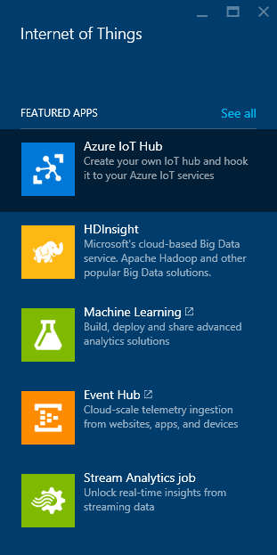
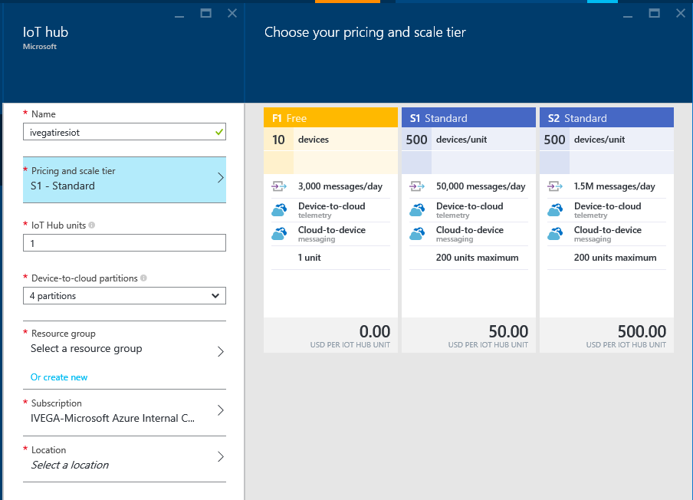
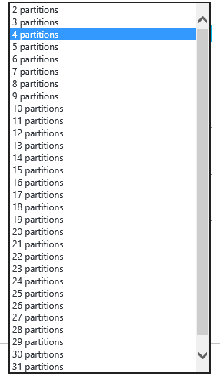
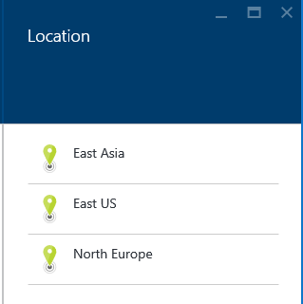
IoT Hub Creation Blades
Partitions are for event hub processing and ingest
Pricing is based on #of devices and hub units (messages)
Notes:
Can I change it later? Yes from free to paid or from S1 to S2. No path for Standard to free

Slide 35
Device-to-cloud messages
Interface
AMQP and HTTPS device-side endpoint
AMQP service-side endpoint
Device and service SDKs
Compatible with Event Hubs
Partitioned receiver, client check-pointing
Integrations with Azure Stream Analytics, Storm, …
100% compatible with Event Hubs receivers
IoT Hub services for D2C
Millions of simultaneously connected devices
Per-device authentication
Connection-multiplexing:
C2D and D2C traffic
Across multiple devices for gateway scenarios
IoT Hub
Device id
D2C receive endpoint
D2C send endpoint
C2D queue
endpoint
C2D send endpoint
Device …
Device …
IoT Hub management
Device …

Slide 36
Cloud-to-device messages
Interface
AMQP and HTTPS device-side endpoint
AMQP service-side endpoint
At-least-once semantics
Durable messages
Device acknowledges receipt (Send - Receive - Abandon OR Complete)
TTL and receipts
Per-message TTL
Per-message positive and negative receipts
Command lifecycle pattern
Use correlated D2C for responses
Use feedback information to retry
Store command state in command registry
IoT Hub
Device id
D2C receive endpoint
D2C send endpoint
C2D queue
endpoint
C2D send endpoint
Msg feedback and monitoring endpoint
Device …
Device …
IoT Hub management
Device …

Slide 37
Command Control Introduction

Slide 40
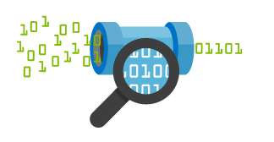

IoT Hub endpoints
Your IoT Hub
Event processing
(hot and cold path)
Device
Device ID
D2C receive endpoint
D2C send endpoint
Device business logic,
connectivity monitoring
C2D queue
endpoint
C2D send endpoint
Field GW/
Cloud GW
Msg feedback and monitoring endpoint
Device …
Device …
Device provisioning and management
Device identity management
Device …
IoT Hub management
Notes:
IoT Hub exposes a set of conceptual endpoints to access its functionalities.
There are two endpoints for each device: one to send D2C msgs, one to receive C2D msgs.
Devices can connect two both endpoints over the same connection.
FGW and CGW are able to represent multiple devices by simultaneously connecting to D2C and C2D endpoints for many devices at the same time.
On the app back-end side, the D2C receive endpoint is used by the event processing pipeline (ASA, Storm, custom, …), and by the device runtime logic component, which handles requests and command responses that come from devices.
The device runtime logic component also uses the C2D send endpoint to send notifications and commands to devices.
It also uses the msg feedback and monitoring endpoint. This is critical for IoT solutions where devices are reachable only through IoT Hub. In these very common scenarios, any problem on the connectivity between device and IoT Hub cannot just be reported as errors back to the device, but also to the app back-end in the form of events on this feedback endpoint. This makes possible the kind of monitoring that is required to achieve high operability of an IoT solution.
In addition to these runtime endpoint, IoT Hub also has a device identity mgmt endpoint that is used by your solution’s device provisioning and mgmt component.
Finally, an IoT Hub Manage endpoint is used to set security, functional, performance parameters.

Slide 41
Connect Your Devices
Event Hub
Event processing and insight
(e.g. hot and cold paths)
IP-capable
Cloud protocol
gateway
Field gateway
Device business logic,
Connectivity monitoring
PAN-devices
Application
device provisioning and management
field
cloud

Slide 42
Azure IoT Reference Architecture
Devices and Data Sources
Data Transport
Device and Event Processing
Presentation
Azure IoT Hub
Data Visualization & Presentation
IP capable devices
Provisioning API
Solution Portal
Device State Store
Agent
Device Registry Store
Existing IoT devices
Stream Event Processor
Agent
Gateway
Storage
Analytics/ Machine Learning
Low power devices
Agent

Slide 43
Azure IoT Suite SDKs
Device-facing
For devices and field gateway
Platforms
RTOS (FreeRTOS)
Linux (Ubuntu, Debian, Fedora, Raspbian, Angstrom)
Windows 7/8/10
ARM mbed
Android
iOS
…
Languages
C, Java, C#, Javascript
Service-facing
For back-ends and cloud gateway
Languages
.NET C#
Java
Node

Slide 44
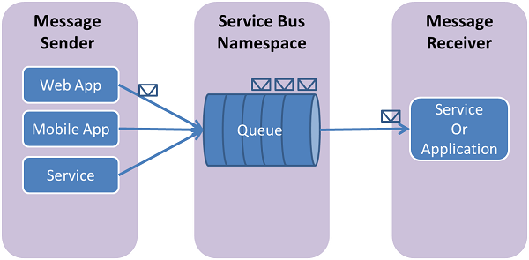
Queueing
Sender sends message to the queue, then receiver can pull off the queue
First In First Out (FIFO) message delivery
One-Way message
To imitate, Request/Reply pattern, a return queue needs to be created the sender will then for the responses

Slide 45
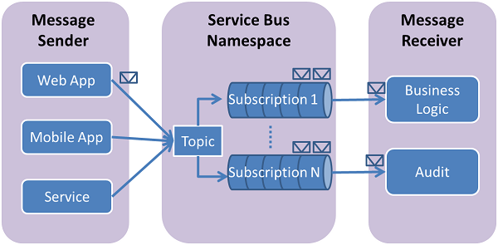
Topics
Senders send messages to the SB that are then distributed to multiple subscribers.
Each subscriber has their own independent queue
TIP: Remember to allocate the right amount of space utilized for your queues or messages will bounce off SB.

Slide 46
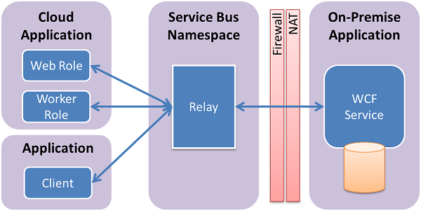
Relay
Exposes an endpoint for clients outside the network to gain access to internal systems

Slide 47
When use Which?
Message Correlation (Queues)
High throughput needs; work usually completes in minimal time
It’s ok for the replying party to directly know of the reply destination
Subscription Correlation (Topics)
Decoupling of replying party and destination
Longer lived jobs that may require moving handling between subscriptions by ways of moving rules
Session Correlation
Reliable multiplexed duplex communication

Slide 48
Pricing
Basic: Up to 100 connections, no extension Standard: 1000 connections incl. | Price (US Dollars)
Throughput Unit Hour (Basic) | 0.015 | TU per hour
Throughput Unit Hour (Standard) | 0.03 | TU per hour
Ingress Events | 0.028 | per 1,000,000 events
Cost Brokered Connections (1k-100k) | 0.00004 | connection/hour
Cost Brokered Connections (100k-500k) | 0.00003 | connection/hour
Cost Brokered Connections (500k+) | 0.00002 | connection/hour
Storage Overage >TUs*84GB |  | local-redundant Azure storage charge-through

